Slide 1
Contemporary Social Movements Through Twitter: The Cases of Madison and Occupy Wall Street
By: Kirk Winans
Advisors: Professor Striegnitz and Professor Seri
Interdepartmental Computer Science/Political Science Project

Slide 2
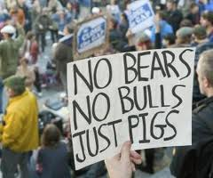
Table of Contents
Introduction to the Protests
Research Questions
Hypotheses
Why Twitter?
Twitter Analysis
Interviews
Social Movements
Conclusions

Slide 3
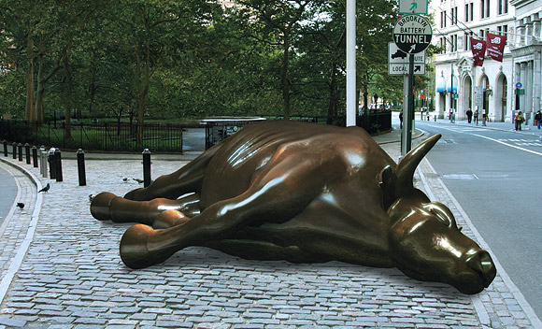
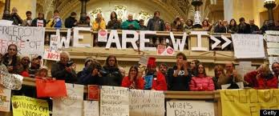
Introduction to the Protests
Governor Walker’s Bill
Madison Protests
Occupy Wall Street

Slide 4
Research Questions
How do the protestors themselves see the movement?
What is unifying these protests?
Is the Occupy Movement inspired by the Madison protests?
Are they following in the tradition of previous social movements or do they constitute a new movement in opposition to capitalism and our political system?

Slide 5
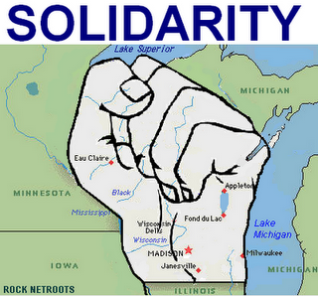
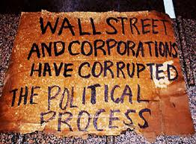
Hypotheses
Wisconsin - Labor Protests
Wisconsin -> OWS = New Social Movement

Slide 6
Why Twitter?
Used by protestors around the world
Voice Opinion

Slide 7
Analysis of Tweets
Main actor activity
Activity over time
Main concepts tweeted
Hashtags
#wiunion
#occupywallstreet & #ows
@occupynaked RT @AngryVoters: To be With the 99% Obama Must Fire His
JP Morgan Banker Chief of Staff Daley #OccupyWallStreet #OWS
#OccupyWallStNYC #O... Tue Nov 08 15:55:45 +0000 2011 - tweet id 133935750210256896 - #9 tweet details

Slide 8
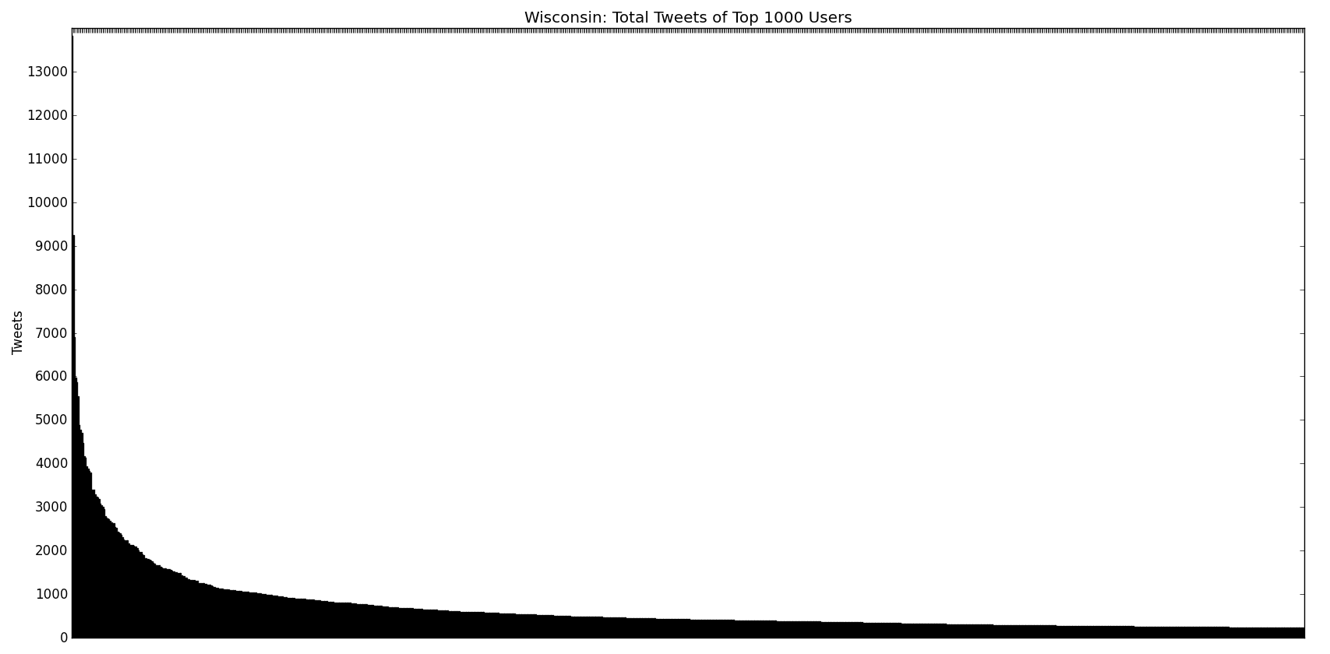
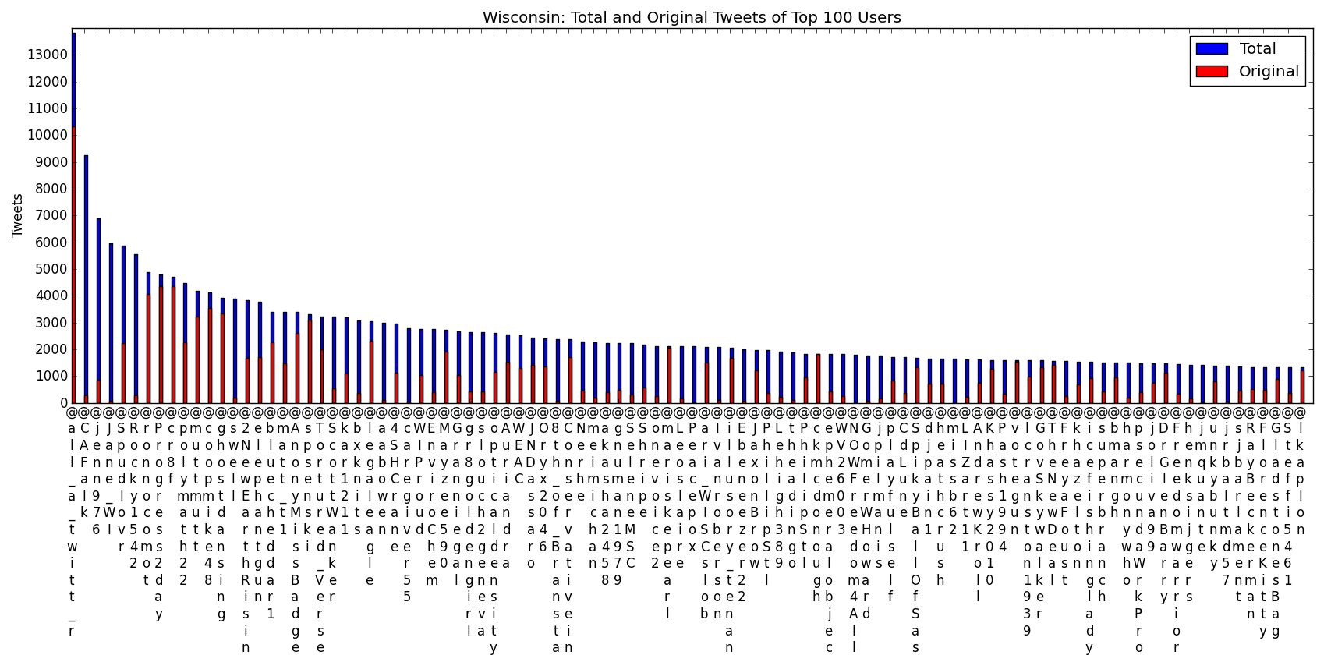
Main Actor Activity - Wisconsin
% of Tweets by top 99 users: 20.05%
Number of Users contributing 80% of tweets: 5659 (6.54% of users)

Slide 9
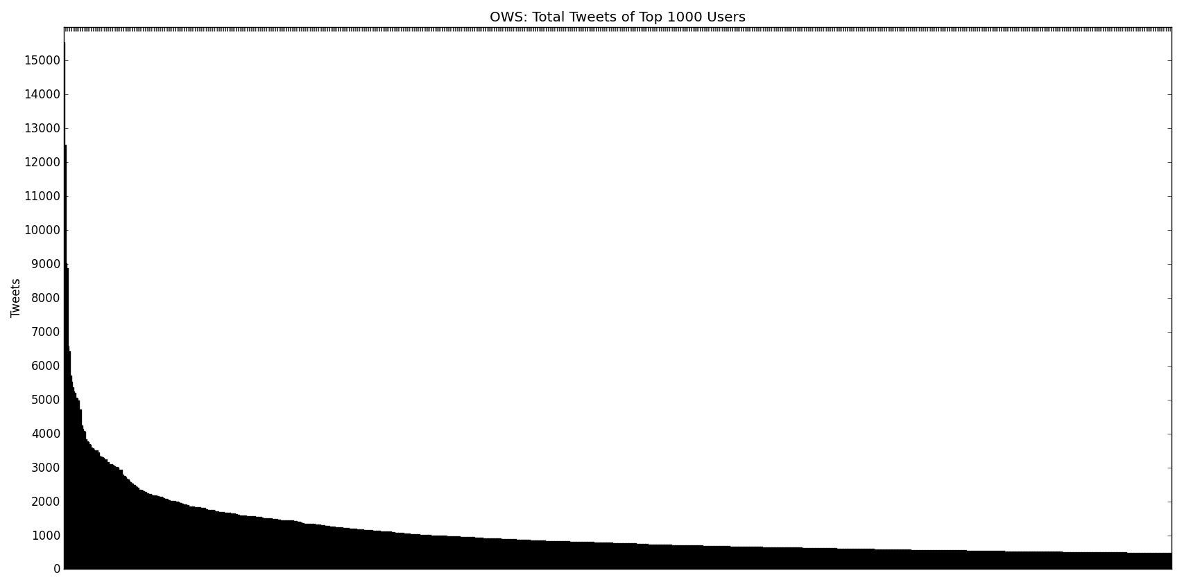
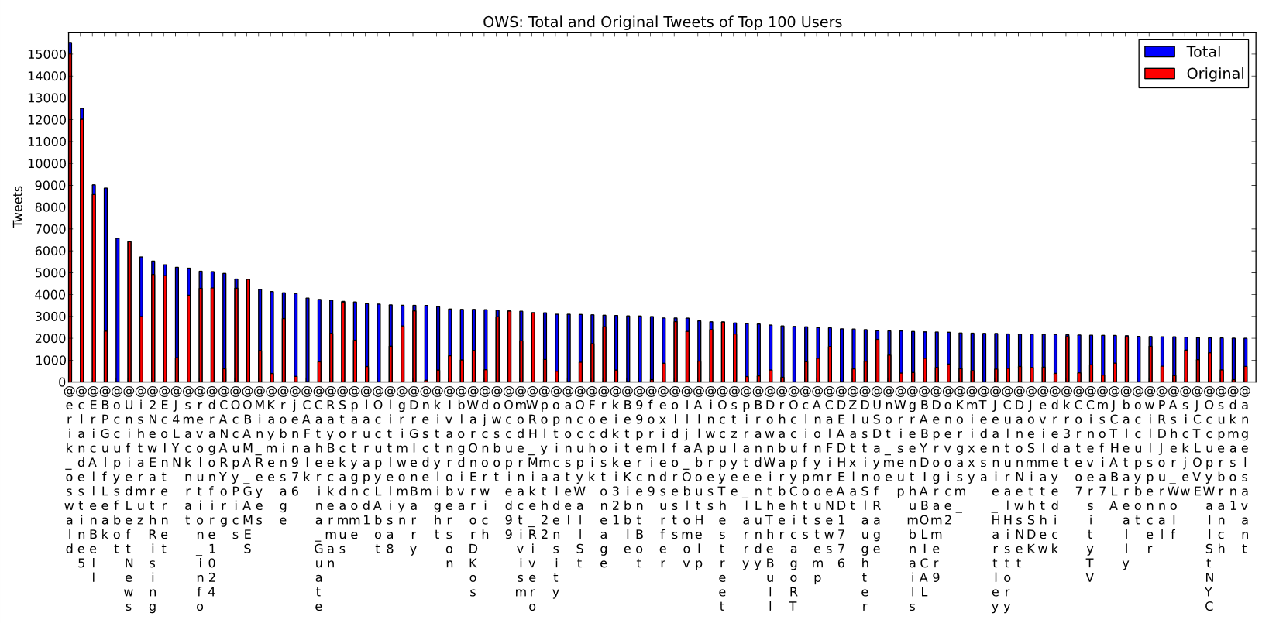
Main Actor Activity - OWS
% of Tweets by top 99 users: 6.97%
Number of Users contributing 80% of tweets: 62,537 (12.83% users)

Slide 10
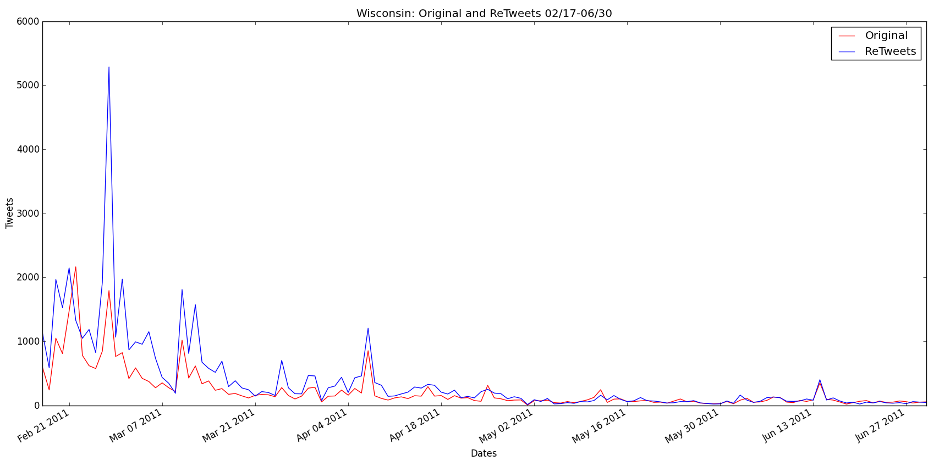
Activity Over Time - Wisconsin
Feb 21, Feb 26, Mar 9, Mar 10

Slide 11
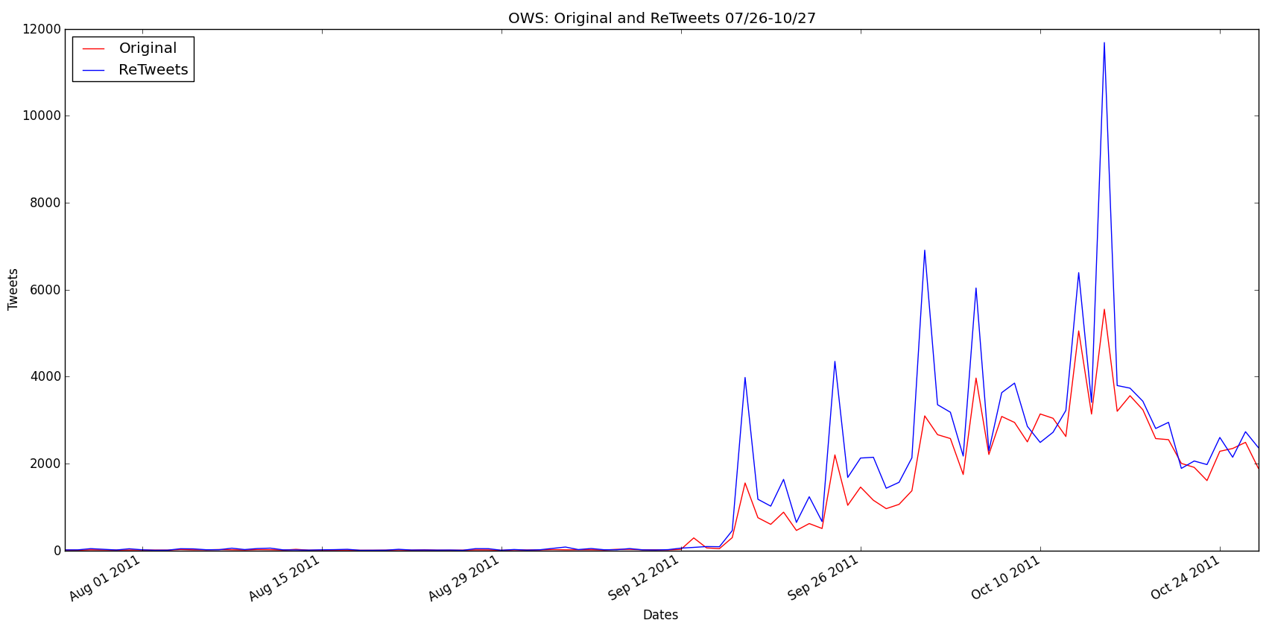
Activity Over Time - OWS
Sep 16, Oct 4, Oct 14

Slide 12
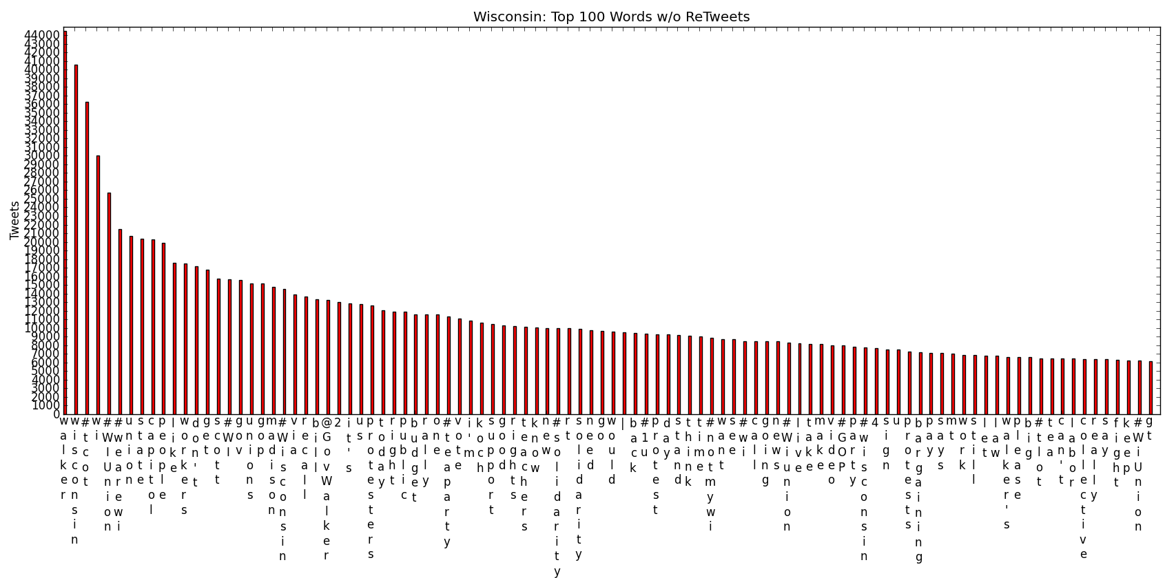
Main Concepts - Wisconsin
Excludes #wiunion, #p2
Solidarity, Unions, Protests, Teaparty

Slide 13
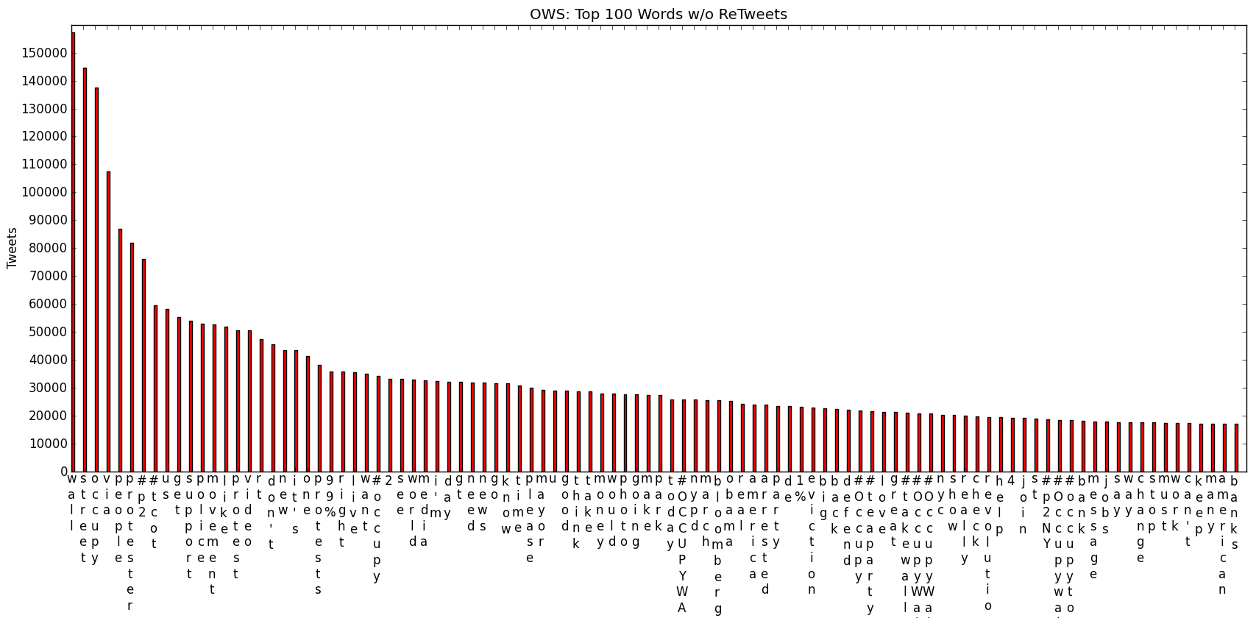
Main Concepts - OWS
Excludes top 4 #tags
Protest, Police, 99%, Revolution, Teaparty

Slide 14
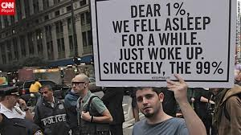
Traditional Interviews - OWS
How the protestors see the movement
“Movement of Awakening”
Motivations
Corporate Greed
Inequality
Poverty

Slide 15
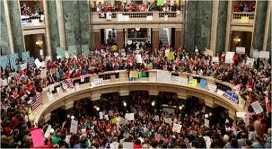
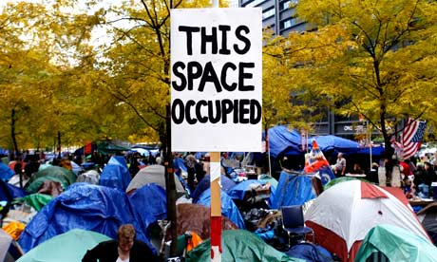
Social Movement Literature
Sidney Tarrow
Repertoires of Contention
Master Collective Action Framing
Cycles of Protest

Slide 16
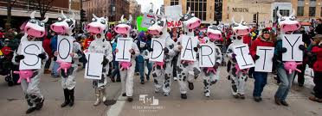
Conclusions
Labor -> Wisconsin -> Occupy Wall Street
Repertoires of Contention
Occupation, Twitter, Solidarity
Master Collective Action Framing
Workers’ Rights -> Oppose Corporate Influence
Cycles of Protest
Wisconsin -> OWS

